Slide 1
Higher Education Institutions & Student Enrollment An Introductory Analysis on IPDES 2012-2020 Data
by Carlotta Amaduzzi camaduz1@umbc.edu
Data 606 ~ Capstone Project University of Maryland Baltimore County Dr. Chaojie Wang

Slide 2
Project Overview
Data collection & cleaning
Initial exploratory analysis
Application of Machine Learning Algorithms
Conclusions & Further Analysis

Slide 3
Rationale
Access to Higher Education is essential
to maintain a more equitable society
to inspire individual professional and financial growth
to ensure social mobility
Understanding the factors that influence undergraduate enrollment in Higher Education Institutions (HEIs) can have a double positive effect:
on the HEIs themselves which are for all practical purposes fairly large (business) organizations
on the impact increased levels of education can have on society as a whole

Slide 4

Research Focus & Results
Yes!
Based on publicly reported information regarding HEIs, do the selected and reported features affect student enrollment choice?
With an eye to I.D.E.A. (Inclusion, Diversity, Equity, and Access), is there evidence of changes in enrollment in HEIs over time?
In particular, with an eye towards Standardized Tests and Blind Admission Policies, are there changes emerging over time?

Slide 5
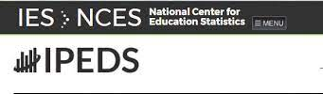
The Data
Publicly available information
Integrated Postsecondary Education Data System (IPEDS) web site (https://nces.ed.gov/ipeds/datacenter/DataFiles.aspx )
Different data files reported by Federally Funded HEIs
Institutional ID data
Institutions Offerings
Students’ Enrollment data
Admissions’ Policies
Only reported data

Slide 6
Status of Education
Higher Education Institutions
Enrollment
Selection Processes

Slide 7
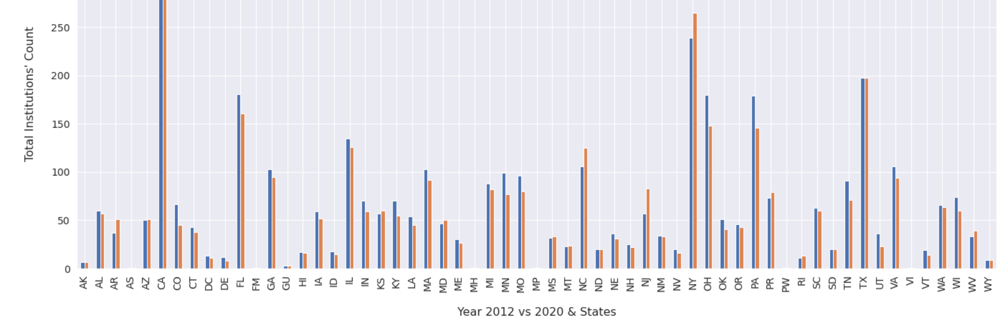
HEIs ~ Contraction across almost all States

Slide 8
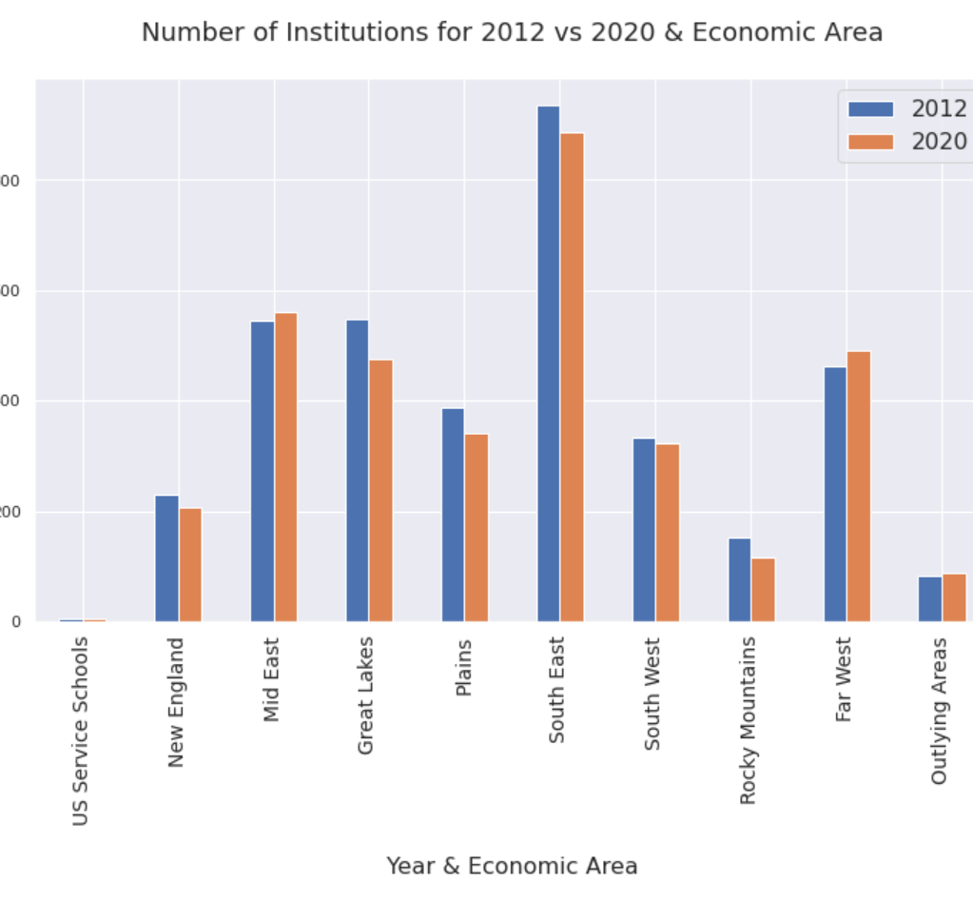
HEIs ~ Contraction across almost all Economic Areas

Slide 9
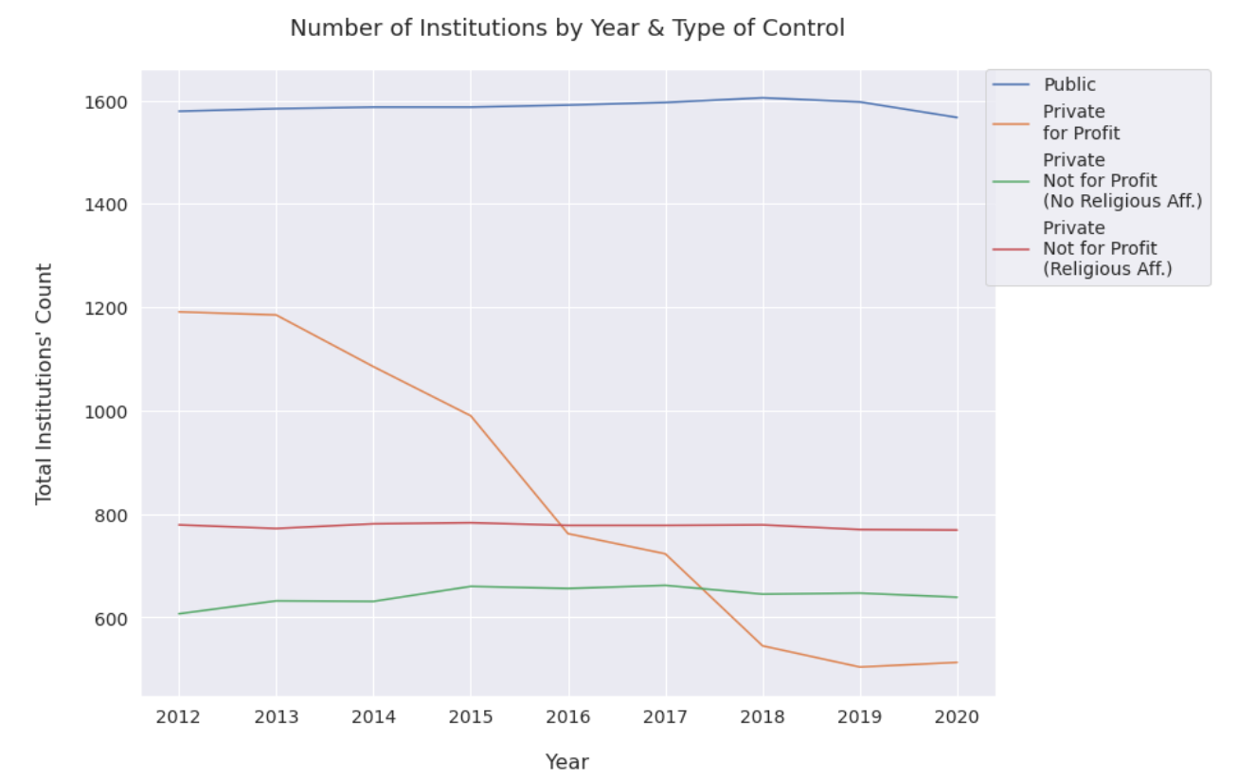
HEIs ~ Significant Contraction in Private For-Profit Institutions

Slide 10
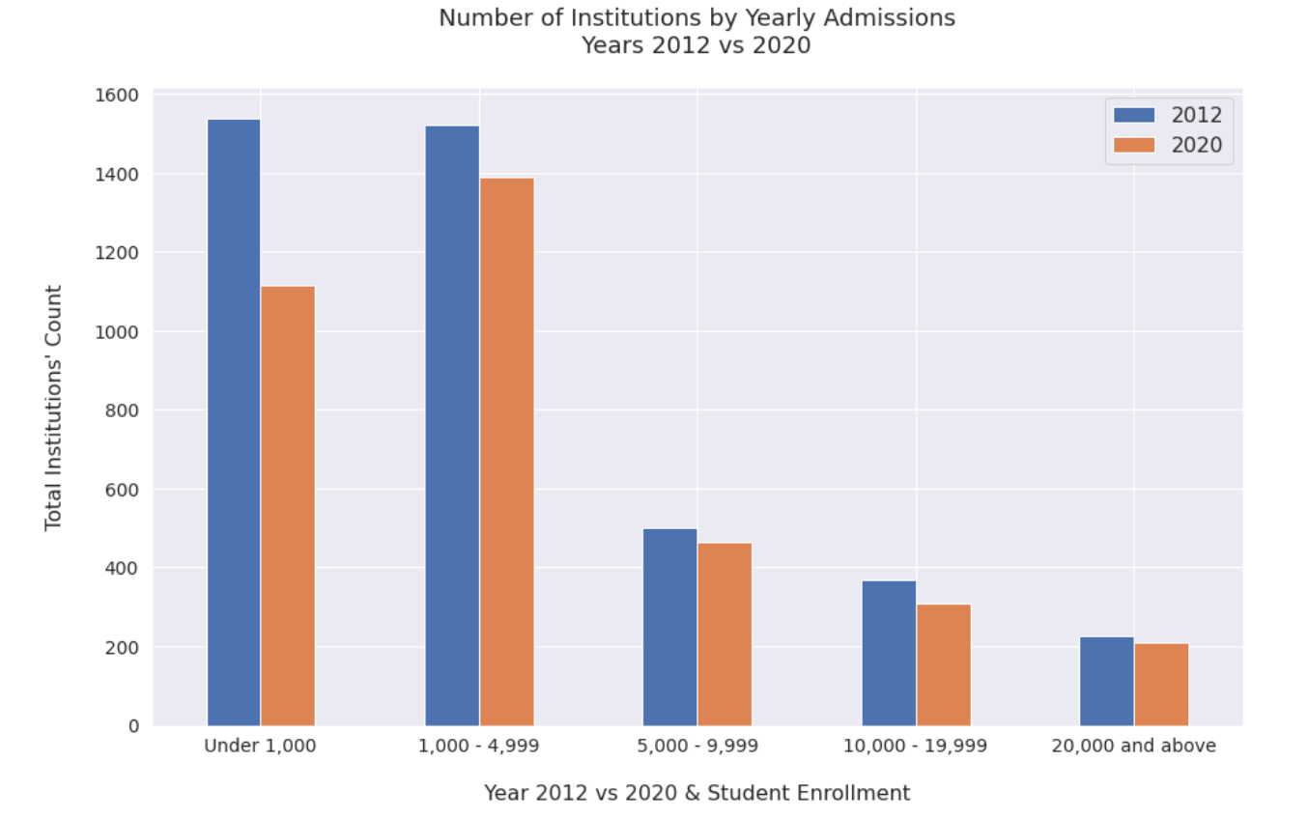
By Size

Slide 11
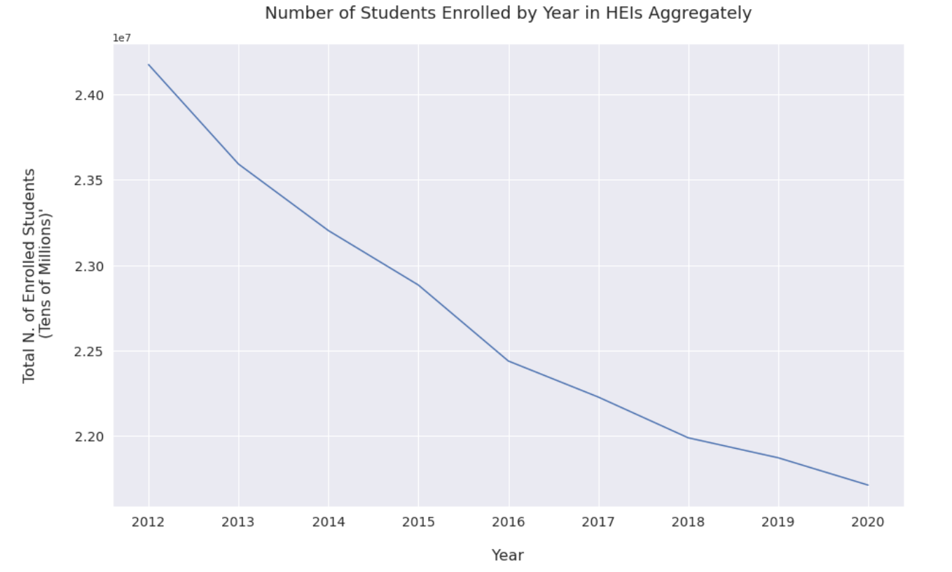
Enrollment

Slide 12
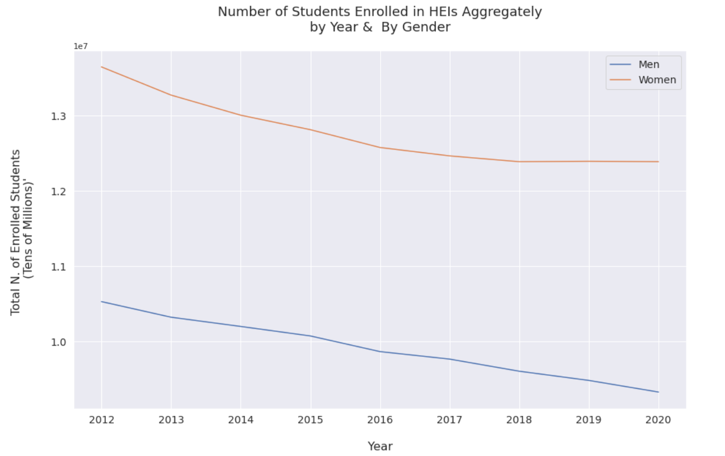
By Gender

Slide 13
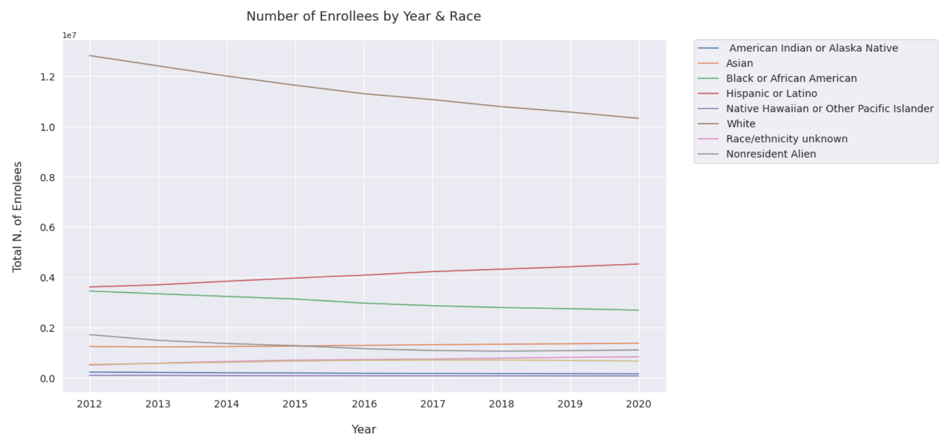
By Race
NOTE: HEIs with Open Enrollment Policies included

Slide 14
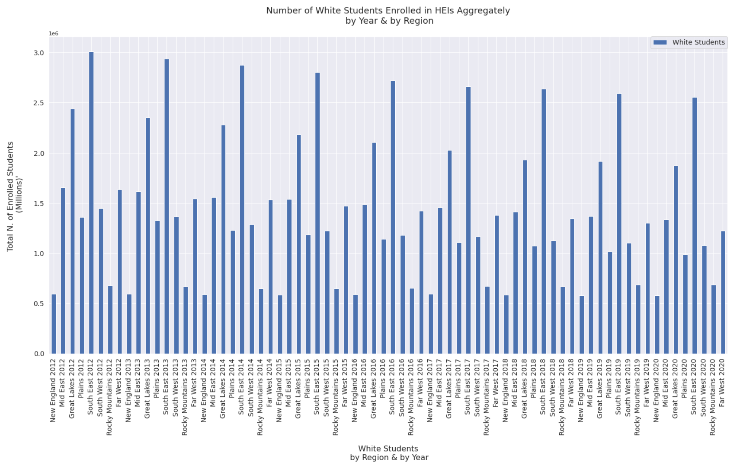
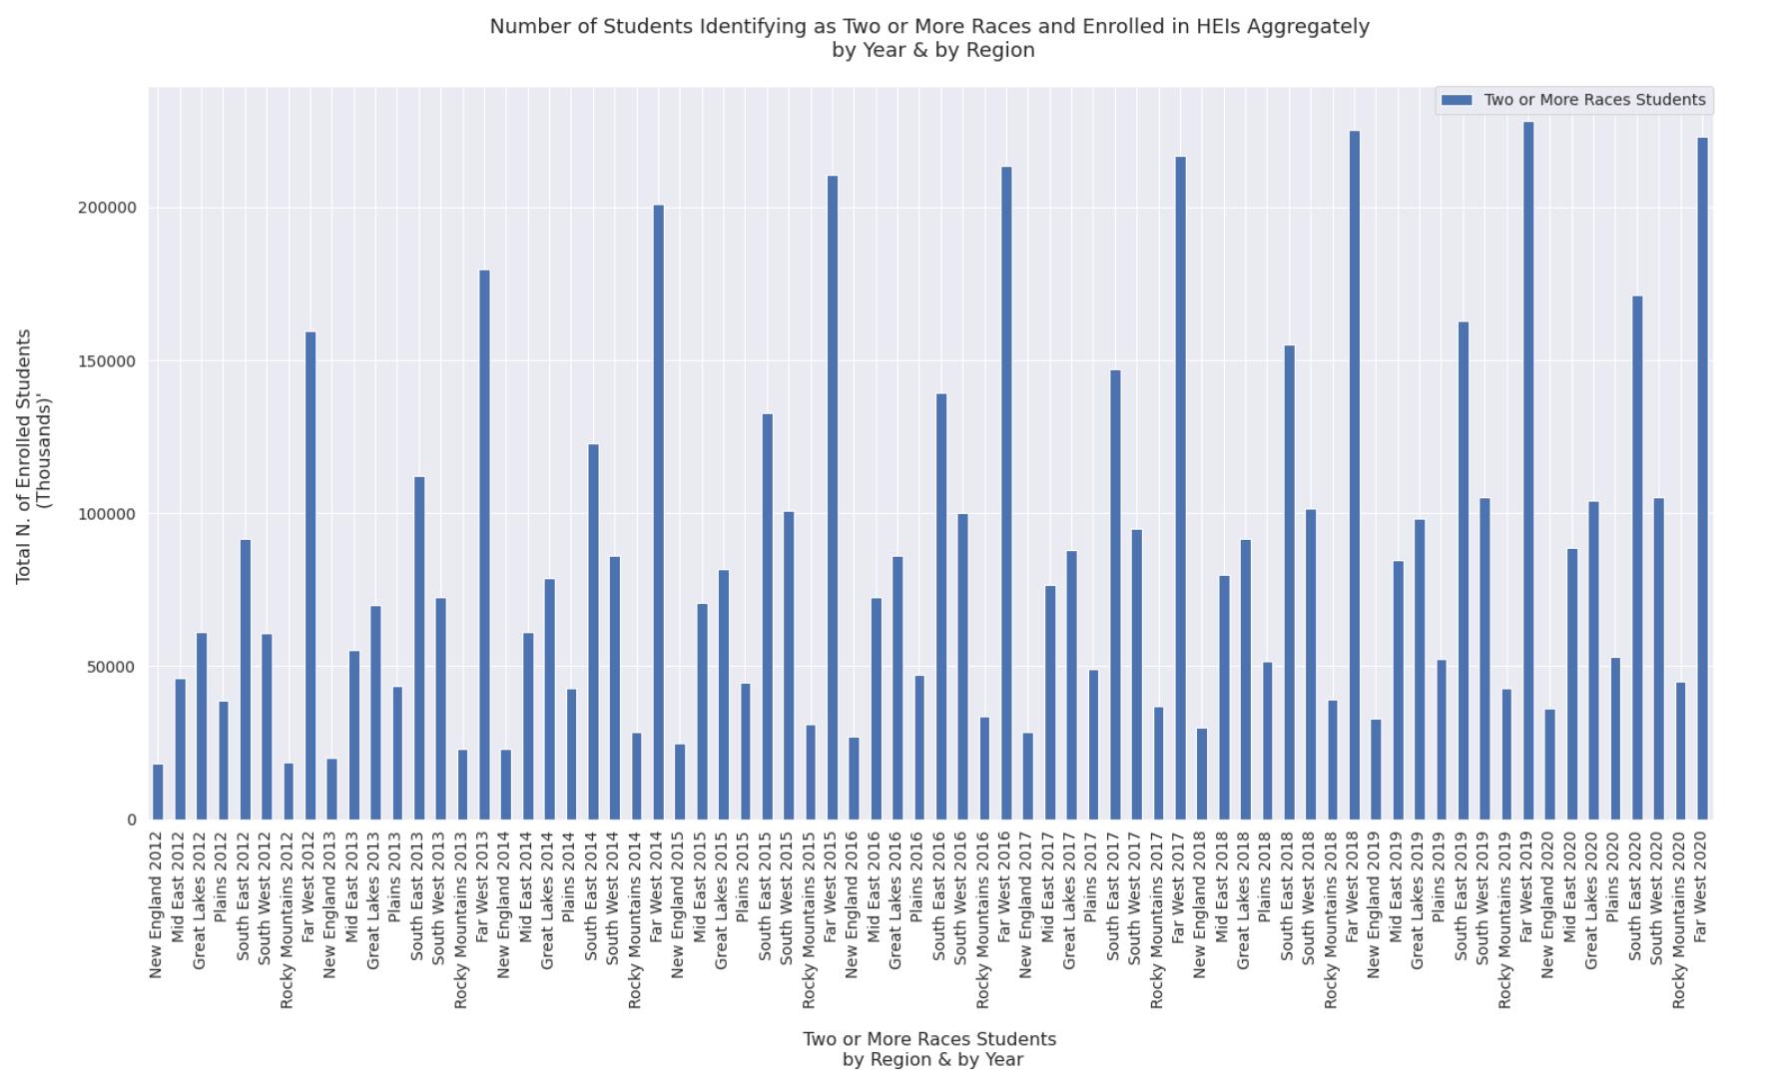
Whites vs Two or More Races

Slide 15
Step I Focus on 2020 Data to select best approach
Step II Apply Strategy on 2012-2020 Data

Slide 16
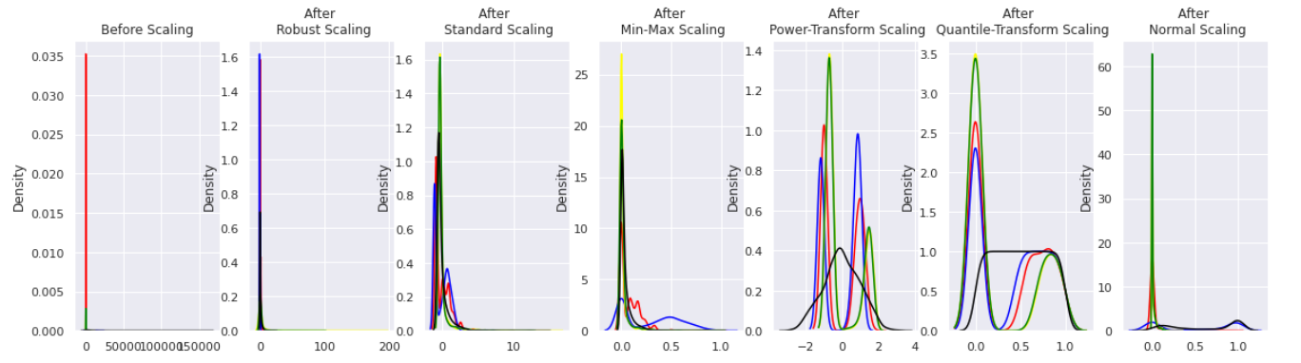
2020 Data
45 Variables (5 Numerical Variables vs the rest Categorical Application Fees; Room and Board fees (aggregately); Total n. SAT scores ;Total n. ACT Scores ; Total n. of Enrollments (Target)
Unbalanced Data (Preprocessing required ) - OneHotEncoder vs. – RobustScaler
Linear Regression

Slide 17
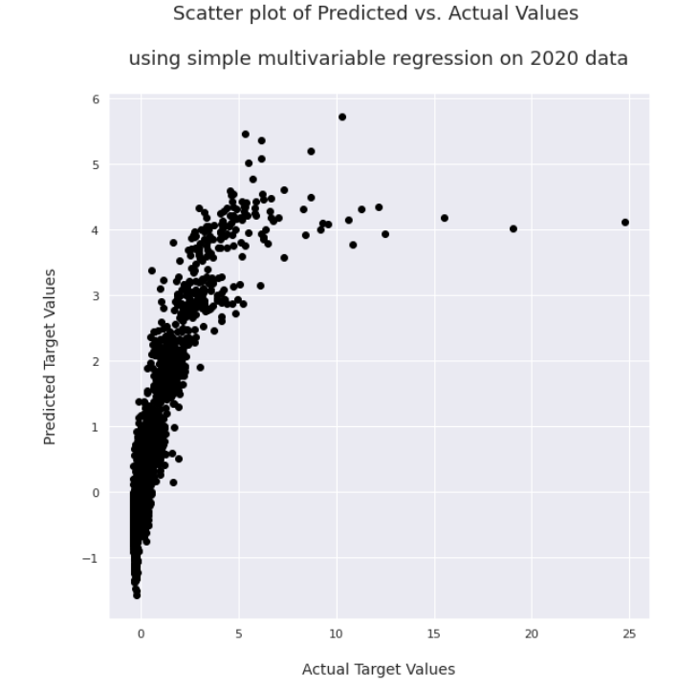
2020 Data
Linear Regression
67% accuracy on Training data vs. 60% accuracy on Testing data
Explained Variance score (also known as the Coefficient of Determination or R Squadre) is only 60%
Predictions consistently underestimate Actual data
Causes:
Outliers
Unbalanced data
Simple test case no feature pre-selection

Slide 18
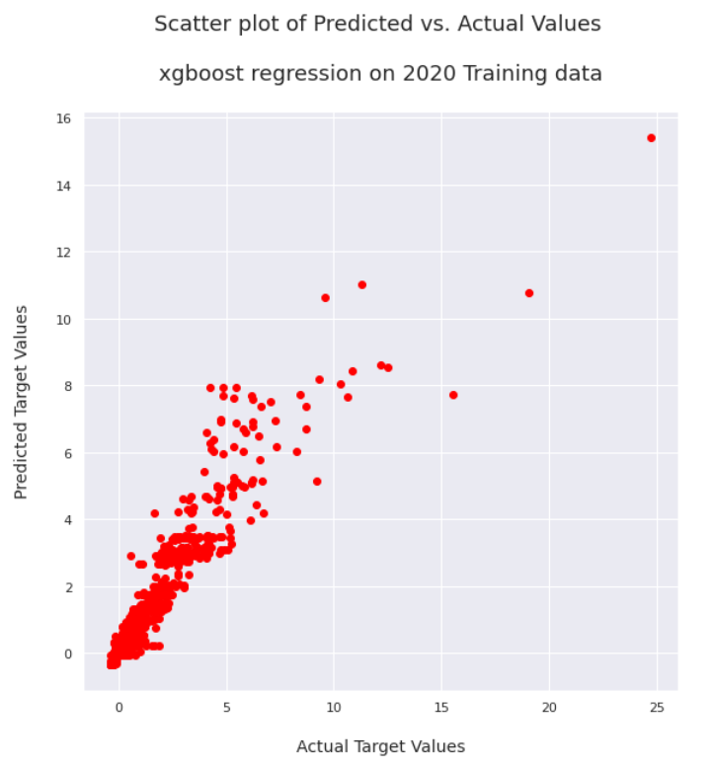
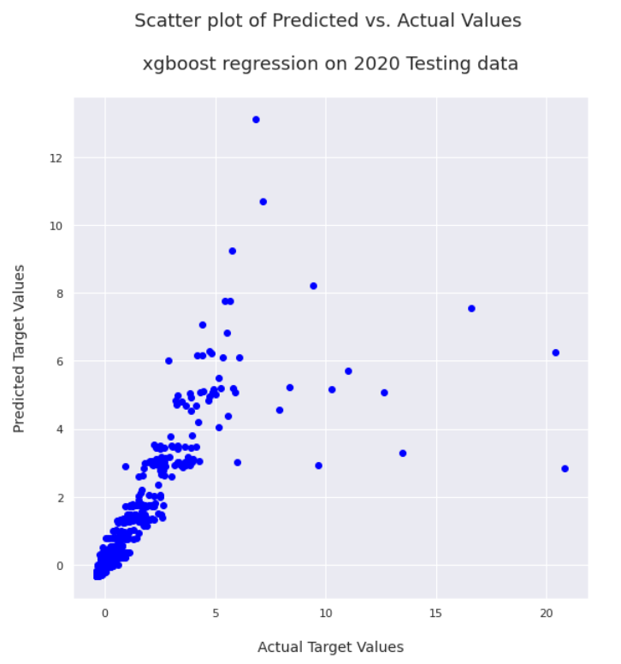
2020 Data
XGBoost Regression– gradient descent paired with random tree selection to handle large datasets and improve predictions
Training data accuracy of approximately 90%
Testing data accuracy of about 68%
Overall improvement of about 13%.

Slide 19
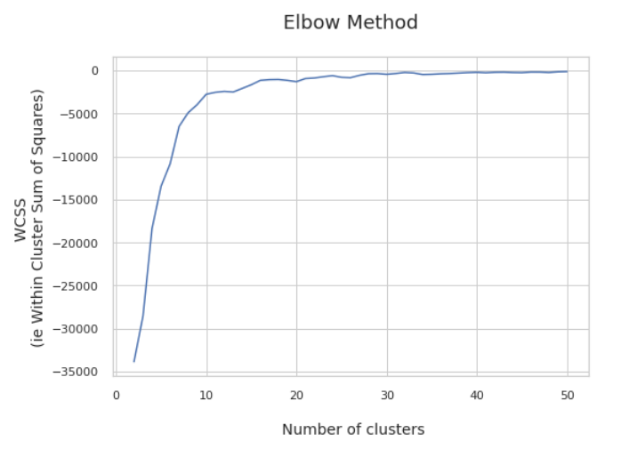
2020 Data ~ K Means
Clustering by State
Tested k value between 2 and 50 Best 9 ~ Economic areas
Gradient of the inertia is negative = = function is decreasing (Distance between points and centroids)
Homogeneity score for 9 number of clusters is: 0.0610
Completeness score for 9 number of clusters is: 0.1645

Slide 20
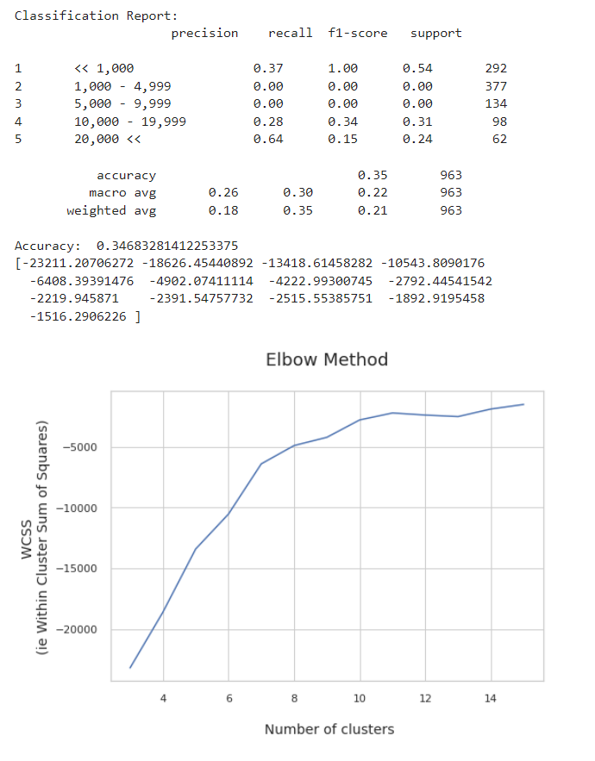
2020 Data ~ K Means
Clustering by Institutional Size
Homogeneity score for 2 number of clusters is: 0.08 Completeness score for 2 number of clusters is: 0.62
Homogeneity score for 3 number of clusters is: 0.13 Completeness score for 3 number of clusters is: 0.51
Homogeneity score for 4 number of clusters is: 0.14 Completeness score for 4 number of clusters is: 0.42
Homogeneity score for 5 number of clusters is: 0.15 Completeness score for 5 number of clusters is: 0.34
Homogeneity & Completeness Both Higher than for k clusters of States!

Slide 21
2012 – 2020 Data

Slide 22
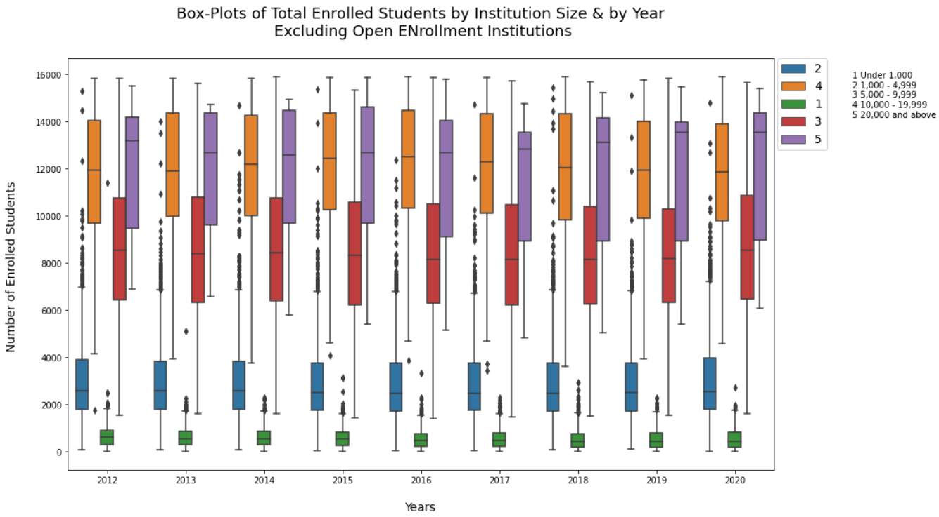
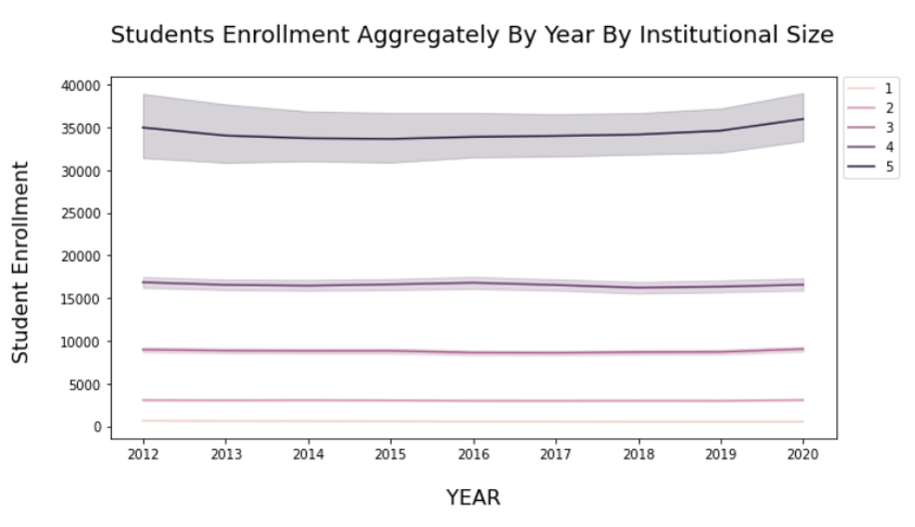
Students’ Enrollment
Student enrollment by Institutional Size
Not fluctuating as much as we might expect
Larger HEIs experienced the largest fluctuations over time

Slide 23
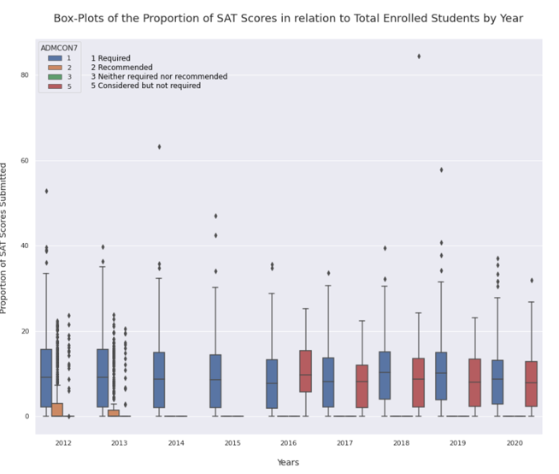
2012-2020 SAT Scores’ Submissions
Number of Institutions Recommending SAT Scores vs HEIs Considering but not requiring SAT Scores
Change in policy or change in reporting?
(Same is true for ACT Scores)

Slide 24
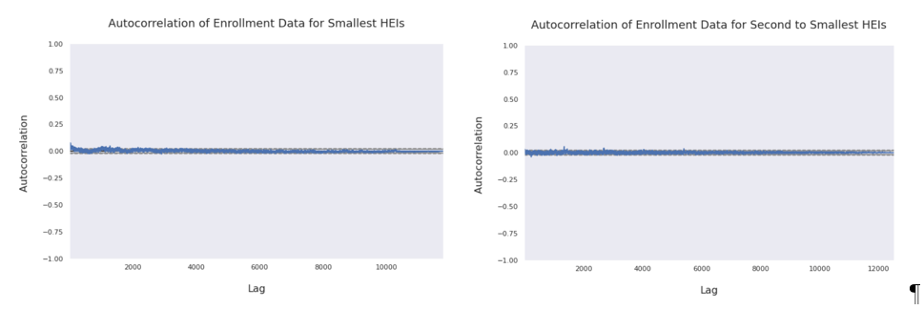
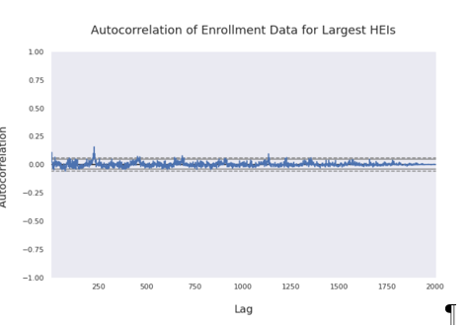
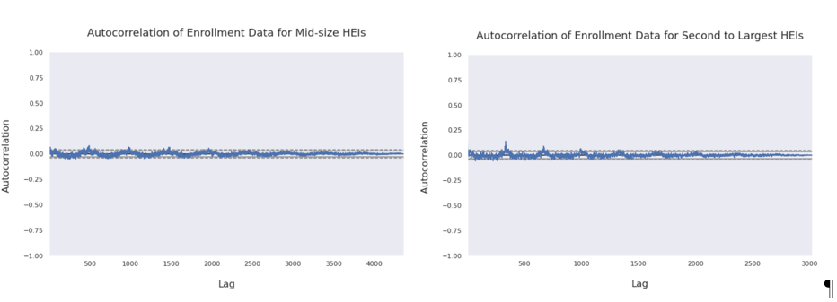
2012 – 2020 Enrollment By HEIs Size & Lag
No particularly significant autocorrelation for the data
Larger HEIs may be the most autocorrelated with previous levels of enrollment

Slide 25
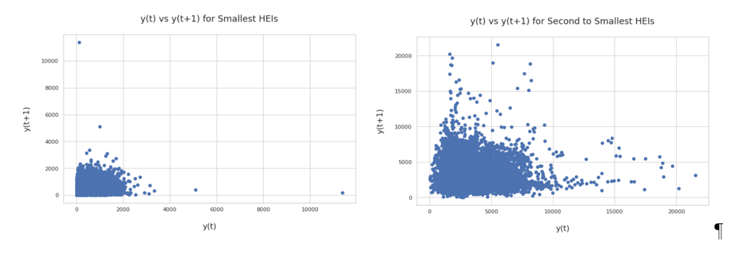
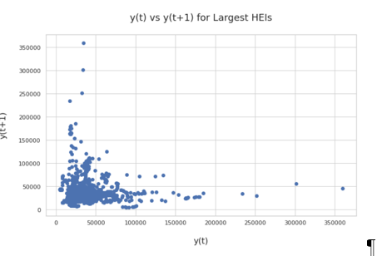
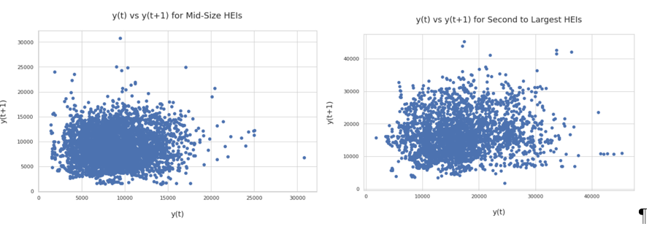
Enrollment By HEIs Size & Lag
No particularly significant autocorrelation for the data
Larger HEIs may be the most autocorrelated

Slide 26
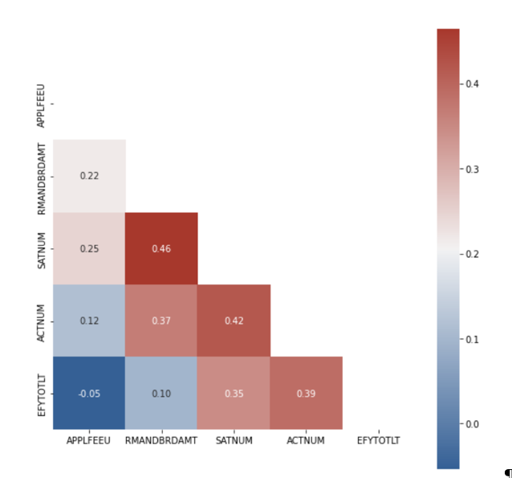
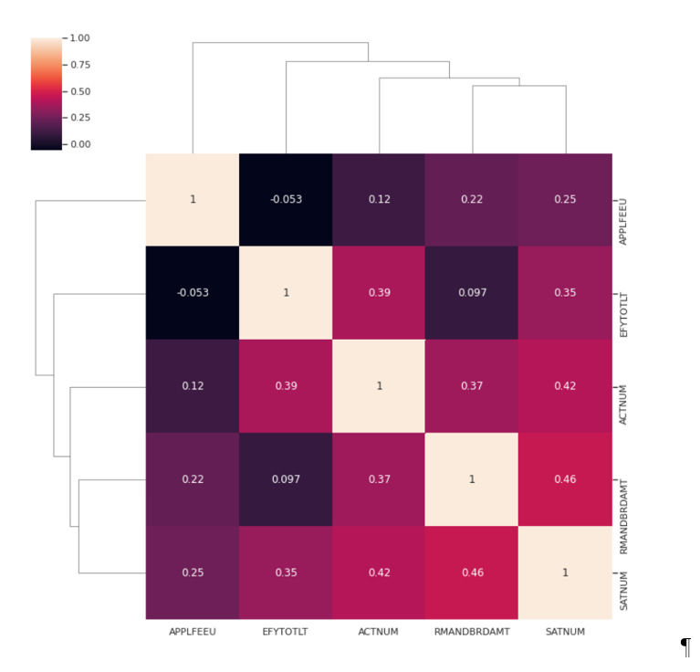
Quantitative Features Pearson’s Correlation

Slide 27
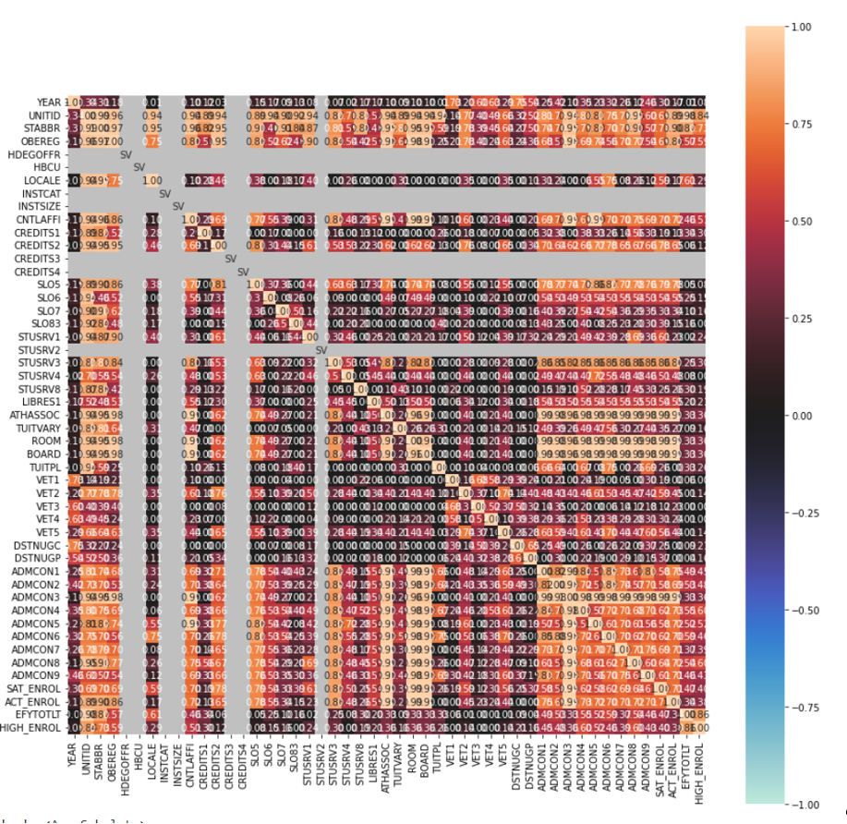
Categorical Features Largest HEIs
Largest HEIs ~ Categorical Variables’ Associations
Location seems to matter
Traditional High School related variables are associated to enrollment
Gives us a sense of how uniform this HEIs are
None are are HBCU
All offer both Undergraduate and Graduate programs (which makes sense)
Most are Private organizations ( 86 vs 8) with the ones Not for profit constituting the larger portion (72 vs 14)
All accept Advance Placement credits (at least on paper)
All have academic counseling offices

Slide 28
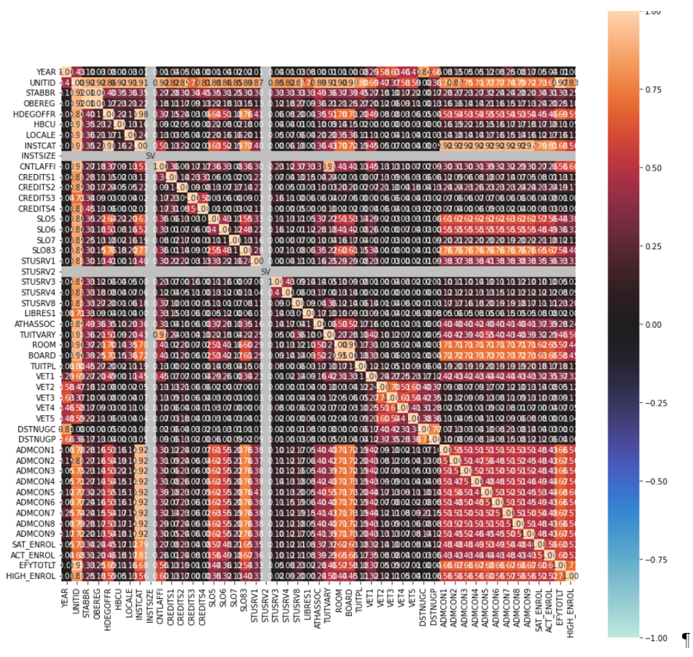
Categorical Features Mid-Size HEIs
Mid-Sized HEIs ~ Categorical Variables’ Associations
Greatest number of categorical variables are relevant
Traditional High School related variables are associated to enrollment

Slide 29
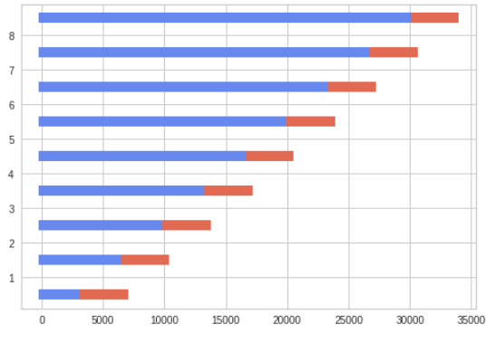
Time Split Method
Walk forward method of selecting Time-Series data

Slide 30
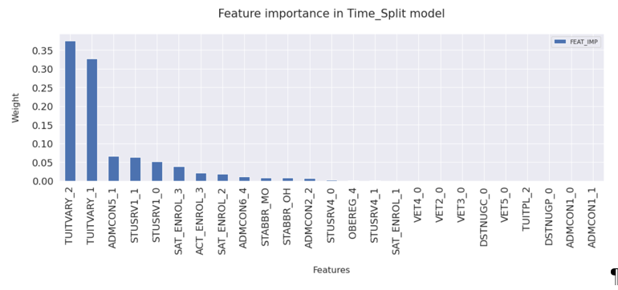
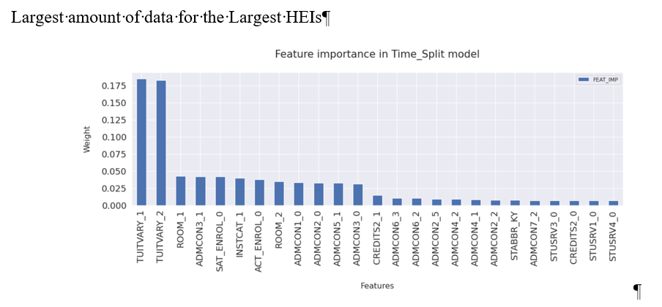












XGBoostRegression ~ Largest HEIs
1st Split versus Last Split ~ Largest HEIS
In State vs Out of State Tuition cancels itself out
Change in policy and importance with respect to SAT Scores (highlights yellow)
Recommendations & Secondary School records remain Required for enrollees in many of the Largest schools (highlight Blue)
Formal demonstration of competencies & School Rank are losing importance (Highlight peach)
1 Required
5 Considered but not required
2 Recommended
3 Neither required nor recommended

Slide 31
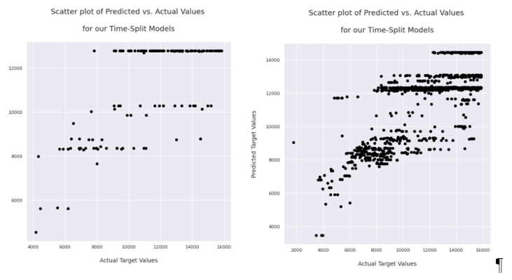
XGBoostRegression ~ Largest HEIs
1st Split versus Last Split ~ Largest HEIS
Root Mean Square Error (RMSE) around 2000
Training accuracy ranges between (50.24%, 59.25%) )
Testing accuracy between (32%, 62.75%),
Not a great job at predicting enrollment levels based on the features

Slide 32
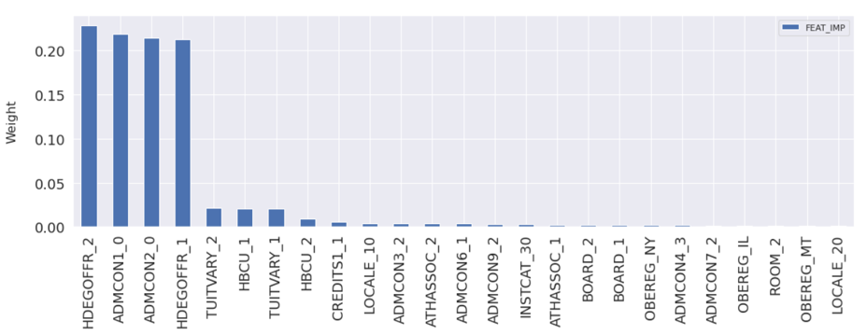
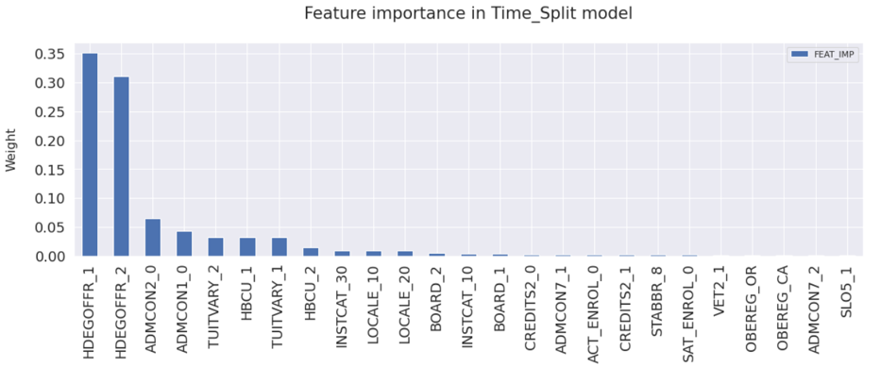















XGBoostRegression ~ Medium Sized HEIs
1st Split versus Last Split ~ Mid-Size HEIS
Graduate Level Courses Cancel each other out (almost)
HBCU status has lost distinguishing appeal
SAT Scores are practically not reported Very low proportion & Low importance
Location matters more
Shift away from traditional academic reports as a shift in presence of these features appears (blue Highlights) BUT distinguishing factors between HEIs: Secondary School Rank (2), HS GPA (1) Secondary School Records (3) , Admission Test Scores (7) (Recommended but less influential)

Slide 33
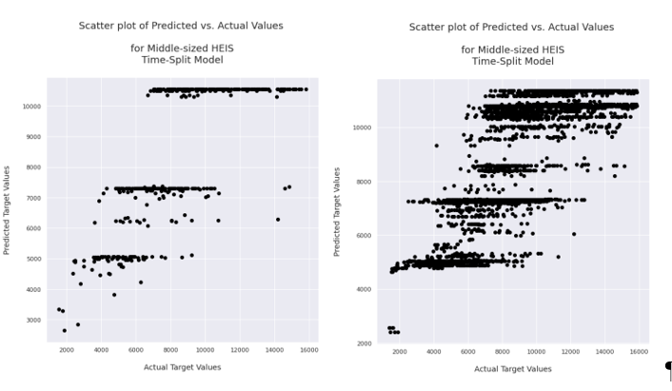
XGBoostRegression ~ Medium Sized HEIs
1st Split versus Last Split ~ Mid-Size HEIS
Root Mean Square Error (RMSE) for this size of HEIs ranges between about (1854 and 2074),
Training accuracy ranges between (56.77% and 62.7%)
Testing accuracy between (54.19% and 60.54%)
Better job at predicting enrollment levels based on the features, c closer around our 45 degree line

Slide 34
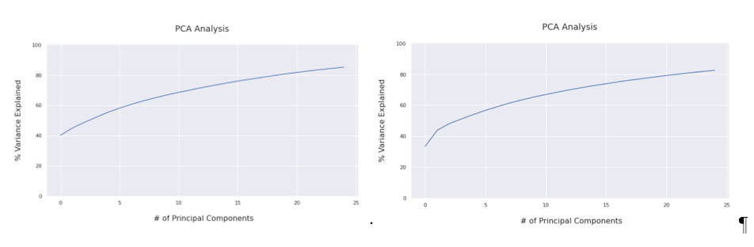
Principal Component Analysis
1st Split versus Last Split ~ Mid-Size HEIS
Cumulative Variance explained by first 3 features 90%

Slide 35
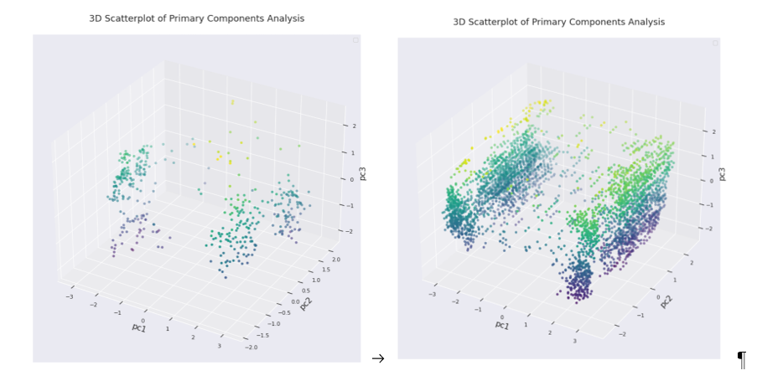
Principal Component Analysis & DBSCAN - Density Based Spatial Clustering Algorithm with Noise
Clustering of data reflects Features importance

Slide 36
Reported features affect student enrollment choice – BUT we did NOT prove Causal Effects
Changes in enrollment patterns exist – BUT are they reflecting changes in Society or Policy Decisions by HEIs?
Standardized Tests are being used less (differently?) in relation to Students – BUT why? Economics vs Equity?
Conclusions & Questions

